Slide 1
Spiritual Ancestors
Honoring the Mythic Dead

Slide 2
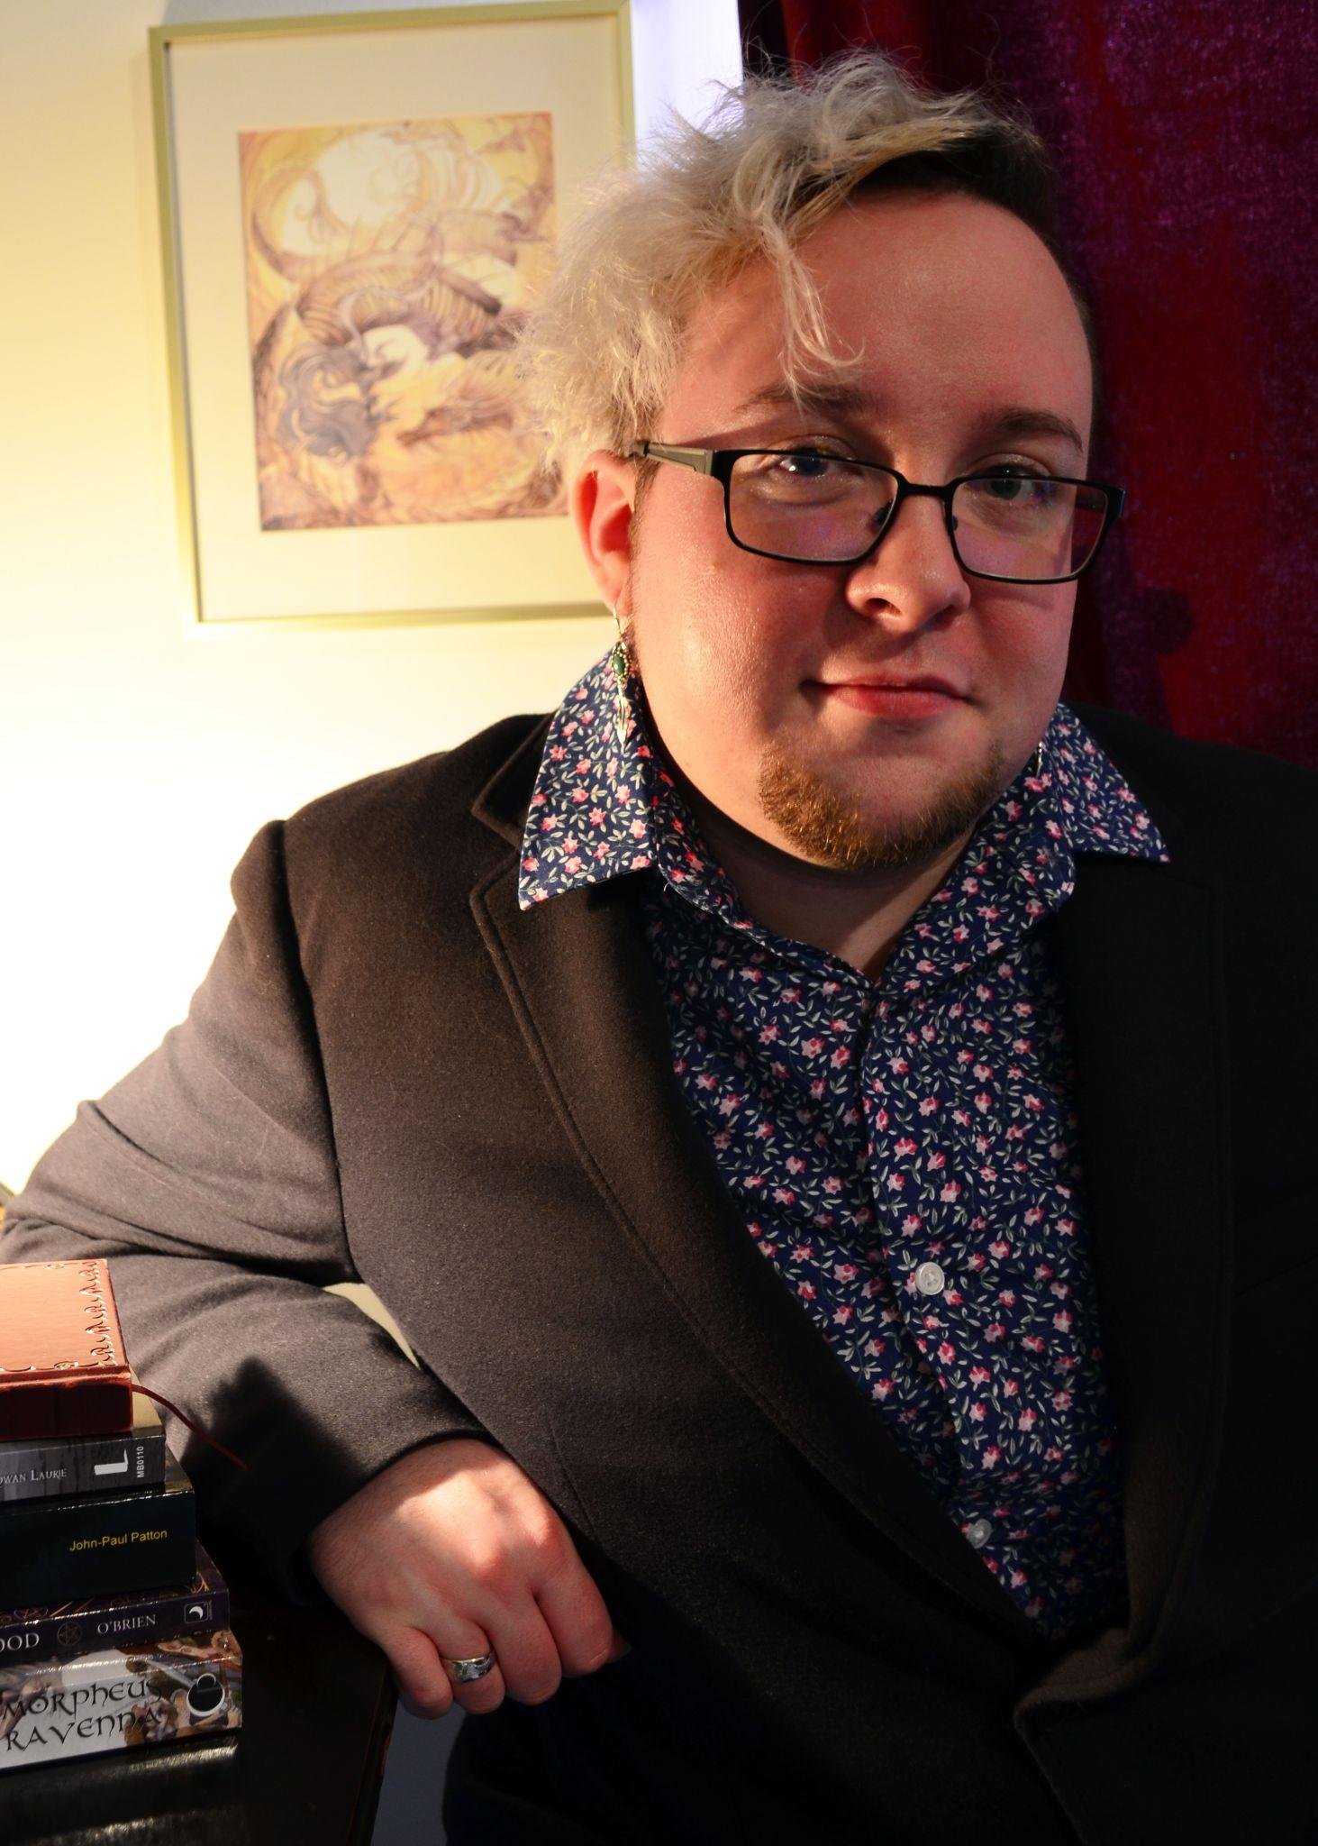
Who am I? I’m Kai!
Practicing pagan for over 12 years, Studying Occult for 17 years
Dedicated as a priest to The Mórrígan in 2020
Student of Irish Tradition though Irish Pagan School
Practice Fairy Witchcraft and Star Worship
Spirit worker and diviner

Slide 3
What is Ancestor Worship?
From Merriam Webster:
ancestor worship noun
The custom of venerating deceased ancestors who are considered still a part of the family and whose spirits are believed to have the power to intervene in the affairs of the living.

Slide 4
Ancestor Worship cont.
Using Worship vs Veneration
Worship - the feeling or expression of reverence and adoration for a deity (Oxford)
Veneration - great respect; reverence (Oxford)
Generally we can use these terms interchangeably, use the word that works best for you
Most folks tend to have an ancestor shrine, where they leave offerings and have consistent time set aside for work with them

Slide 5
Ancestral Classifications
Beloved Dead - Those that we knew closely and loved in life. For example - parents, grandparents, close friends, pets
Known Dead - Those whose names we know but never grew close to in life, those that died before we knew them. Family trees are a good way to think about this
Unknown Dead - Ancestors whose names have been forgotten, going back many generations
Ancestral Guardians - Ancestors that act as guardians, gatekeepers, or go-betweens to keep descendants safe and communicate with Other Spirits easier
Mythical Dead - This gets its own slide!

Slide 6
Who are the Mythical Dead?
Generally people tend to think of Culture heroes - Heracles, Fionn mac Cumhaill, Gilgamesh, King Arthur, etc.
Sometimes they end up deified and worshiped as gods
Catholic Saints or similar could also be considered Mythical Dead
Modern heroes can be seen as part of this group as well
Many spiritual ancestors can fall in this group

Slide 7
What are Spiritual Ancestors?
Generally not related to us by blood
Can be people in our communities, like teachers, leaders, or other people directly influential to our lives
Also can be people you admire that deeply affected your development, or whose lives made a great impact on yours
Keep in mind there can be overlap too - A close friend can be both a Beloved ancestor and a Spiritual ancestor
Any Questions so far?

Slide 8
What are the benefits of an Ancestor Veneration Practice?
Ancestors generally understand human problems better than Gods do! Working with your ancestors is great for things like money, jobs, and anything especially close to home.
Ancestors also tend to understand human timelines much better
Ancestors are great intermediaries for communication with other spirits
It can give you the chance to help heal generational trauma
Honestly, sometimes it’s just nice to know you’ve always got someone in your corner - Your ancestors want you to be happy and healthy!

Slide 9
Let’s talk about Appropriation vs Appreciation
Appropriation is the action of taking something for one's own use, typically without the owner's permission (Oxford)
Cultural appropriation is generally when a dominant culture takes another culture’s ideas and identity without permission or appropriate context for the practice
Appreciation is shown by engaging with and giving back to these cultures, being respectful of their wishes and practices

Slide 10
Working within different worldviews
What happens when your ancestor has a different religious practice or worldview to yours?
First Step is always to treat them with respect and get their consent - if they don’t want to be involved in your practice, you need to be ok with that.
There are many, many different ways to venerate ancestors, they don’t need to be directly involved in rituals or magical workings
Some methods that don’t involve directly involve your ancestors are things like using them as inspiration, doing research on them, remembering and telling their stories, even offering prayers or words of gratitude and appreciation
Ultimately, work out what’s best for the both of you!

Slide 11
Who can you venerate?
WARNING: DO NOT HONOR LIVING PEOPLE AS ANCESTORS -
This is generally considered taboo, as it is seen as a way of the ancestors ‘reclaiming’ people (a.k.a. Premature death)
It is possible to have non-human ancestors that you venerate - Not only pets, can be beings found in folklore as well.
Your house spirits are not necessarily your ancestors - check with them first!
Generally, feel free to venerate who you want - as always, be respectful, use discernment, and get consent!
Remember that consent goes both ways - if you have an ancestor you don’t want to work with, you don’t have to!
Questions?

Slide 12
Setting up Space for your Ancestors
Do what works for you - Whether it be an expensive showcase, a dollar store shelf, or even a space in your mind, you can have a space that works for you
Have representations of the people you are venerating if you can - Pictures, things they gave you, whatever makes you think of them
Sacrifices and offerings can be as simple as a glass of clean water
If you know what they liked in life, get them that!
Build a consistent practice, again what works for you - do what you can within your ability
Eventually you and your practice will grow and you’ll get more comfortable in that space set aside for them, which makes it easier to communicate!

Slide 13
How to Communicate
Developing a method of communication is important. You can’t always rely on words either - some ancestors may be non-verbal or don’t speak your language. What can you do to get around that roadblock?
Divination - Lots of methods
You can always ask an expert!
Ask for signs, omens, portents, etc.
The more you practice, the easier it will be
Over time, you’ll develop your own consistent method of communication

Slide 14
Resources I Recommend
Books:
Calling to Our Ancestors by Sarenth Odinsson
A Litany for the Many Dead by Rebecca Lynn Scott
The Road to Hel: A Study of the Conception of the Dead in Old Norse Literature by Hilda Roderick Ellis
Honoring Your Ancestors: A Guide to Ancestral Veneration by Mallorie Vaudosie
Blogs and Practitioners:
Sarenth Odinsson
Mortellus
Lady Storm
Jim TwoSnakes

Slide 15
Any Last Questions?

Slide 16
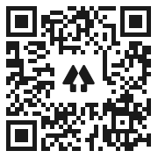
Thank you for coming!
If you have any questions or comments, feel free to reach out!
Email: sanctuaryontheshore@gmail.com
Website: Sanctuary on the Shore
Other ways you can support me here!

